Slide 1
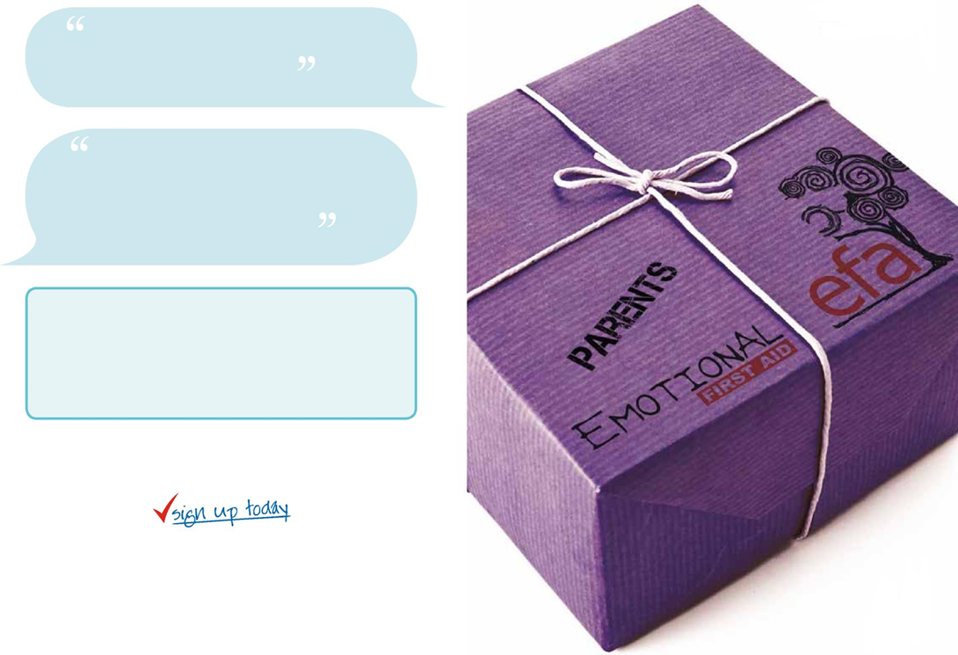


7JB
I was very unsure and shy when the course started but by the end I felt more confident and was happy to join in.
Participant, Parents’ EFA (Solent NHS Trust)
I have realised that everyone is in a similar situation, and that I am not different. More positive about myself. There’s a lot of good in my life and people who care about me.
Participant, Parents’ EFA (Solent NHS Trust)
For more information or to book a place on the course please contact:
Tel: 01628 685642
Email: childrens.centres@achievingforchildren.org.uk

Slide 2
This is not a parenting course, but focuses on a Parents’ own emotional wellbeing; helping them to identify their own early warning signs of emotional distress and develop their own sense of positive emotional health and wellbeing. The course will offer an overview of mental health and well-being in relation to being a Parent.
In a report from the Office of National Statistics a parent is quoted as saying “A parent is only as happy as their saddest child.” ¹
It is our belief that likewise, a child’s emotional well-being and resilience is reflection of that modelled by their parents. If we can promote a greater sense of positive emotional wellbeing with the parents, it may create a healthier emotional environment within the family.
Course Outline
Session 1: What is Parents’ EFA? – Exploring our own behaviours and seeing them as a solution to emotional distress.
Session 2: Emotional Stuckness – Focusing on our own Anxiety. Understanding how it affects us and how we can overcome it.
Session 3: Self Esteem – Understanding the concept of Self Esteem and how we can improve our sense of self.
Session 4: Looking at Communication – How we express ourselves to others and building peer support.
Session 5: The Risks We Pose to Ourselves – Using Peer consultancy looking at the various risks we pose to ourselves and others pose to us.
Session 6: Looking After Yourself – Understanding the concept of Stress and how this manifests itself, especially being a Parent. What we can do to manage this and maintain our own emotional resilience.
We are using the Warwick-Edinburgh Wellbeing Scale to evaluate the efficacy of this training.
Aims:
Explore and rediscover your sense of self
Identify early signs of emotional distress and the solutions we use to manage it
Recognise and understand your own emotional needs
Understand and develop your own positive emotional health
Explore the risks we pose to ourselves
Develop and enhance your self esteem
Gain strategies to manage your own emotional well-being
Develop a support network with other parents
Course Dates:
Meet and greet time: 24th May 10am – 11am
Course dates: Friday 7th, 14th, 21st, 28th June and 5th, 12th July 10am – 12.30pm
Venue:
The Lawns Children’s Centre, Imperial Road, Windsor, SL4 3RU
Free crèche available.
Facilitators: Debbie Oates & Gill Way
¹ Hicks, S., Newton, J. et al, 2011, Measuring Children’s and Young People’s Well-being,
Office for National Statistics and BRASS, Cardiff University.
x

